Slide 1

Saskatchewan House Price Prediction
PROJ-613-R05 Capstone Project
Presented to,
Rahim samei
Submitted By,
Anu Mohan Das :
mohandas9786@saskpolytech.ca
Ivy Alphonse Babu:
babu0832@saskpolytech.ca

Slide 2

Introduction
Real estate prices are volatile and accurate housing price predictions support better decision-making for buyers, sellers, and policymakers.
This project analyzes the key elements that influencing house prices, such as location, property size, market trends, and economic conditions.
Machine Learning (ML), a branch of AI, enables systems to learn from data, adapt, and address real-world challenges like predictive analytics and forecasting.

Slide 3
PROBLEM STATEMENT
The project falls under Data Science, Machine Learning, and Real Estate Market Analysis.
It will integrate web scraping, data analysis, machine learning, and data visualization techniques to predict house prices in Saskatchewan specifically Regina and Saskatoon.
Current method does not provide valuable insights into housing trends or help informed investment decisions.

Slide 4
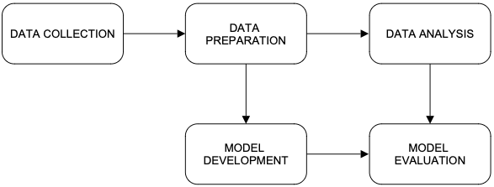
Data Pipeline and technologies
Steps | Technology
Web scraping data | Magical API
2. Data Cleaning and Preprocessing | Using Python, NumPy and Pandas
3. Conducting EDA | Matplotlib, Seaborn
4. Model Development | Linear Regression, Decision Tree and Random Forest
5. Model Validation | Cross Validation-MSE and Rsquared Score
6. User Interface creation | Streamlit
fig1

Slide 5
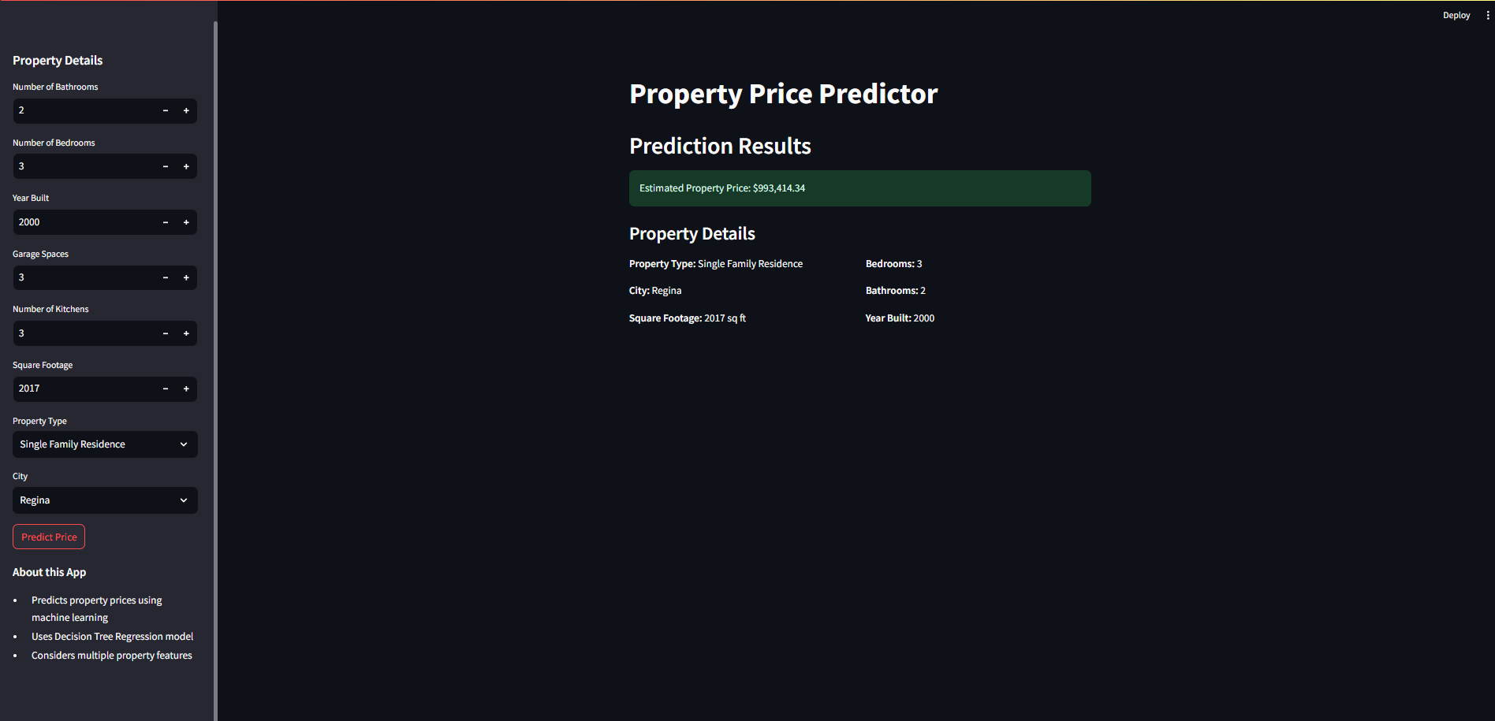
USER INTERFACE

Slide 6

limitation
Data Privacy and Availability
Some websites does not allow data scraping due to data privacy.
Measurement and Reporting Inconsistencies
Eight attributes were only considered for the model namely bathrooms, bedrooms, built_year, garage_space, kitchens, sqft, property_type and city.
Geographical and Cultural Specific
Cities have varying amount of housing data availability. For a better and equal comparison Regina and Saskatoon data were considered.

Slide 7
FUTURE
Data Privacy and Availability
Some site data require permissions for data extraction and may require reaching out to the site owners for permissions.
Scalable Solution
Predictions for more locations including those cities that have less housing data to be made available.
Advanced Feature Engineering
More Attributes for the Model development like infrastructure and cultural based variables to be made available in future for predictions.

Slide 8

Conclusion
Using data science techniques like web scraping, data preprocessing, ML model and Visualization, we can predict house prices more accurately from historical or real-time data.
This can give insight and help real estate professionals make informed decisions in their business and find opportunities for real estate development.

Slide 9

References
1.Slavaspirin. Toronto-housing-price-prediction/GTA_housing.ipynb at master. GitHub, link.
2. Zillow.ca. for web scraping - link
3.W3Schools. Python Machine Learning. link.
4.Data Architecture Simple Model:fig1 Data Collection and Preprocessing link.

Slide 10

Thank you!

